Slide 1



RISC-V Tech. Council CHERI extension for RISC-V
Simon W. Moore, Alex Richardson, Tariq Kurd
With many others involved including: Robert N. M. Watson, Peter Sewell, Peter G. Neumann, Brooks Davis Hesham Almatary, Ricardo de Oliveira Almeida, Jonathan Anderson, Alasdair Armstrong, Rosie Baish, Peter Blandford-Baker, John Baldwin, Hadrien Barrel, Thomas Bauereiss, Ruslan Bukin, Brian Campbell, David Chisnall, Jessica Clarke, Nirav Dave, Lawrence Esswood, Nathaniel W. Filardo, Franz Fuchs, Dapeng Gao, Ivan Gomes-Ribeiro, Khilan Gudka, Brett Gutstein, Angus Hammond, Graeme Jenkinson, Alexandre Joannou, Mark Johnston, Robert Kovacsics, Ben Laurie, Jessica Man, A. Theo Markettos, J. Edward Maste, Alfredo Mazzinghi, Alan Mujumdar, Prashanth Mundkur, Steven J. Murdoch, Edward Napierala, George Neville-Neil, Kyndylan Nienhuis, Robert Norton-Wright, Philip Paeps, Lucian Paul-Trifu, Allison Randal, Ivan Ribeiro, Alex Richardson, Michael Roe, Colin Rothwell, Peter Rugg, Hassen Saidi, Thomas Sewell, Stacey Son, Ian Stark, Domagoj Stolfa, Andrew Turner, Munraj Vadera, Konrad Witaszczyk, Jonathan Woodruff, Hongyan Xia, Vadim Zaliva, and Bjoern A. Zeeb
Approved for public release; distribution is unlimited. This research is sponsored by the Defense Advanced Research Projects Agency (DARPA) and the Air Force Research Laboratory (AFRL), under contracts FA8750-10-C-0237 (“CTSRD”), with additional support from FA8750-11-C-0249 (“MRC2”), HR0011-18-C-0016 (“ECATS”), FA8650-18-C-7809 (“CIFV”), HR001122C0110 (“ETC”), and HR001122S0003 (“MTSS”). The views, opinions, and/or findings contained in this article/presentation are those of the author(s)/presenter(s) and should not be interpreted as representing the official views or policies of the Department of Defense or the U.S. Government.

Slide 2
Approved for public release; distribution is unlimited.
This work was supported in part by the Innovate UK project 105694 (“Digital Security by Design (DSbD) Technology Platform Prototype”, and Innovate UK project 10027440 (“Developing and Evaluating an Open-Source Desktop for Arm Morello”).
This work was also supported by the Defense Advanced Research Projects Agency (DARPA) and the Air Force Research Laboratory (AFRL), under contract FA8750-10-C-0237 (“CTSRD”), with additional support from FA8750-11-C-0249 (“MRC2”), HR0011-18-C-0016 (“ECATS”), FA8650-18-C-7809 (“CIFV”), HR001122C0110 (“ETC”), and HR001123C0031 (“MTSS”) as part of the DARPA I2O CRASH, I2O MRC, and MTO SSITH research programs. The views, opinions, and/or findings contained in this report are those of the authors and should not be interpreted as representing the official views or policies of the Department of Defense or the U.S. Government.
We further acknowledge EPSRC REMS (EP/K008528/1), EPSRC CHaOS (EP/V000292/1), ERC ELVER (789108), the Isaac Newton Trust, the UK Higher Education Innovation Fund (HEIF), Thales E-Security, Microsoft Research Cambridge, Arm Limited, Google, Google DeepMind, HP Enterprise, and the Gates Cambridge Trust.

Slide 3
Motivation: Memory Safety
“Buffer overflows have not objectively gone down in the last 40 years. The impact of buffer overflows have if anything gone up.” Ian Levy, Technical Director at NCSC, 2022
Matt Miller from MS Response Center @ BlueHat 2019:
From 2006 to 2018, year after year, 70% MSFT CVEs are memory safety bugs

Slide 4
Example – Chromium Browser Safety
“70% of our serious security bugs are memory safety problems” www.chromium.org/Home/chromium-security/memory-safety

Slide 5
Nov. 2022

Slide 6
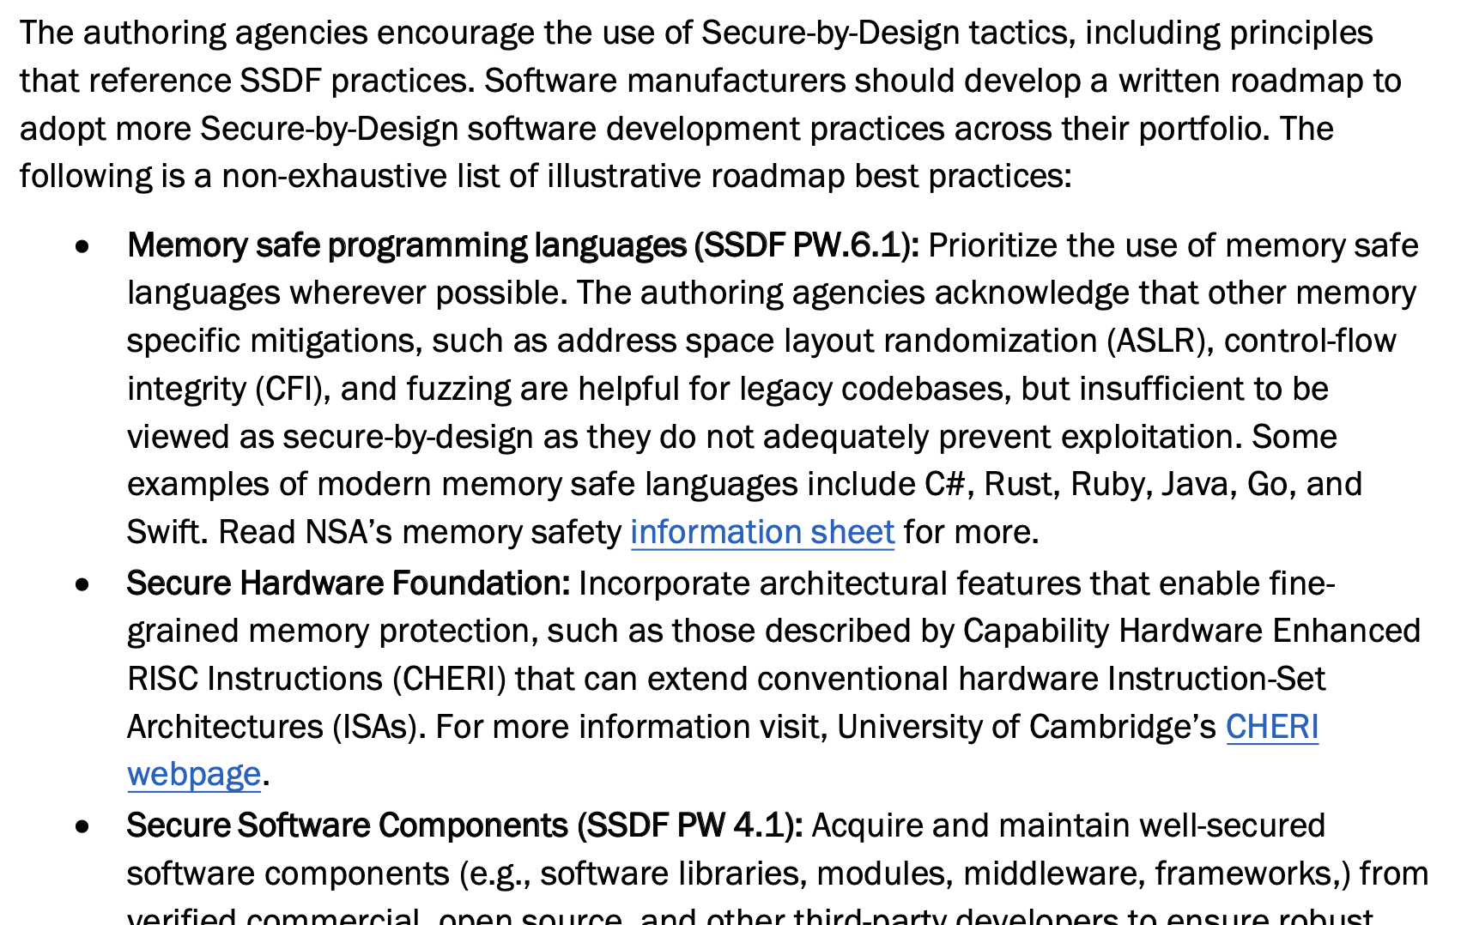
CISA, NSA, FBI, and US ally cybersecurity agencies recommend CHERI
April 2023

Slide 7
How can we do better?
Use memory safe languages like Rust?
Great for new code
Impractical for the vast body of legacy code?
Our approach: make C/C++ and other languages memory safe using CHERI capabilities
Recompile your code for a CHERI enhanced processor to get memory safety
Can also make unsafe Rust much safer!
We’ve now ported more lines of C/C++ code to make it memory safe than exist lines of Rust code on GitHub!

Slide 8
CHERI 128-bit capabilities
Virtual address space
v
1-bit
tag
Upper bound
Pointer address
Memory allocation
permissions
otype
Bounds compressed relative to address
128-bit
capability
64-bit virtual address
Lower bound
Capabilities extend integer memory addresses including jump targets
Metadata (bounds, permissions, …) control how they may be used
Guarded manipulation controls how capabilities may be manipulated; e.g., provenance validity and monotonicity
Tags protect capability integrity/derivation in registers + memory

Slide 9
CHERI enforces protection semantics for pointers
Data
Code
Heap
Globals
Stack
Control flow
Integrity and provenance validity
Bounds
Monotonicity
Permissions
Integrity and provenance validity ensure that valid pointers are derived from other valid pointers via valid transformations; invalid pointers cannot be used
Bounds prevent pointers from being manipulated to access the wrong object
Monotonicity prevents pointer privilege escalation – e.g., broadening bounds
Permissions limit unintended use of pointers; e.g., W^X for pointers
These primitives not only allow us to implement strong spatial and temporal memory protection, but also higher-level policies such as scalable software compartmentalization

Slide 10
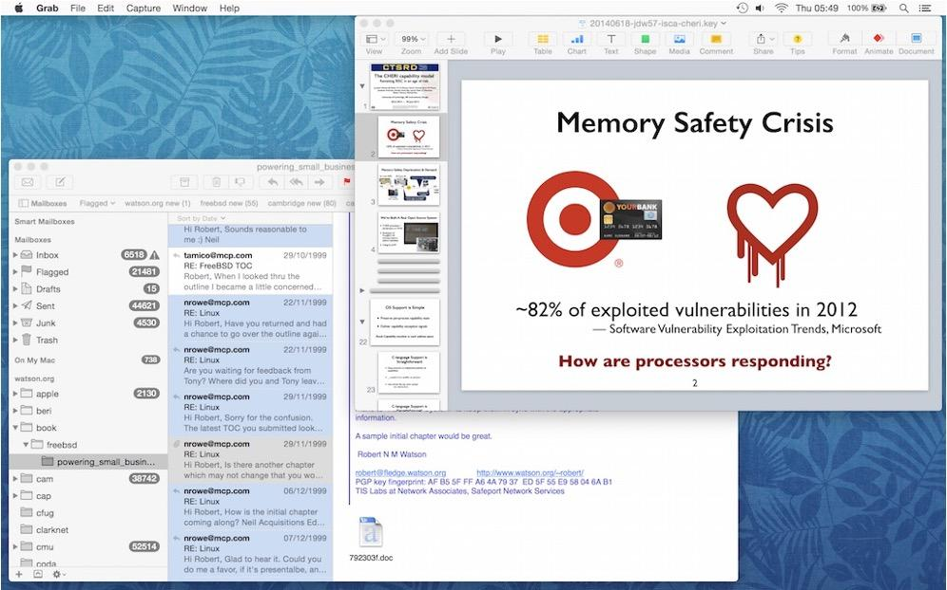
Software compartmentalization at scale
CHERI contains attack within compartment, preventing access to other data
...
Current CPUs limit:
The number of compartments and rate of their creation/destruction
The frequency of switching between them, especially as compartment count grows
The nature and performance of memory sharing between compartments
CHERI is intended to improve each of these – by at least an order of magnitude

Slide 11
Bridging the commercialisation chasm
Proven
Technology
Research
Industry
Real World
Simulation/
prototyping
Arm Morello
CHERI-RISC-V
Research in the Lab
Fundamental
Principles
TRL7: Prototype
demonstration in real world
TRL6: Full OS, toolchain, several processors on FPGA
TRL8: Product completed
and qualified in real world
TRL2: Technology concept
TRL5: Validation on FPGA with modest toolchain
TRL9: Product proven in real world
TRL4: Simulations & initial results
TRL1: Basic principles
TRL3: Proof of concept

Slide 12


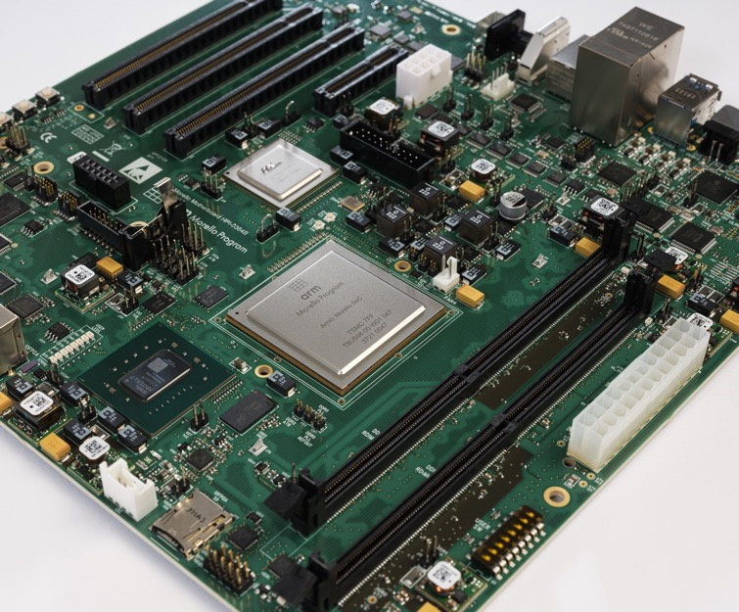
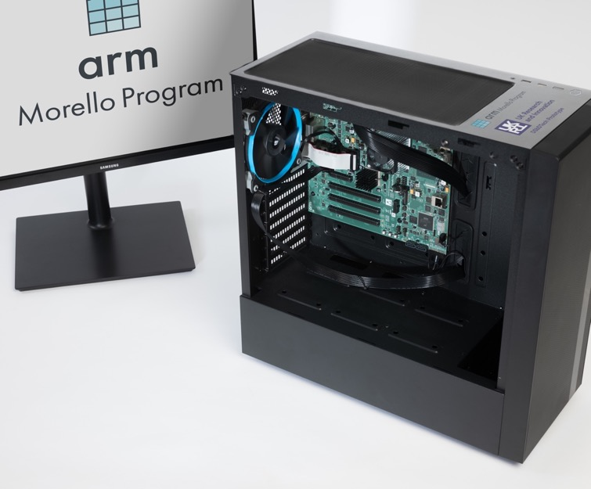
arm Morello Demonstrator Board
Innovate UK – Digital Security by Design Initiative
CHERI enhanced Neoverse N1 quad-core with Mali GPU on TSMC 7mn
No IP encumberment due to “Capability Essential IP” agreement between ARM and University of Cambridge
https://www.arm.com/architecture/cpu/morello
Notes:
Now to the exciting bit – the board has been designed and built and is ready to distribute to partners! All on schedule etc etc firing up Windows, Ubuntu and other Oss.​
Announcement on 20th Jan
​
[The Morello Board is delivered in an ATX case, just need to plug in the power lead, connect an HDMI monitor, USB connection to host system for debug and a mass storage device] ​

Slide 13
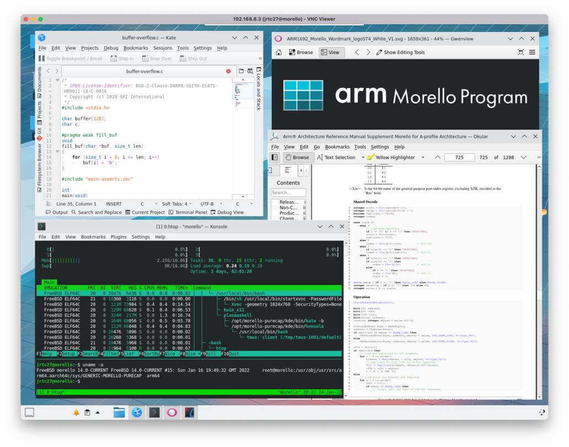
CHERI desktop ecosystem study: Key outcomes
Developed:
6 million lines of C/C++ code compiled for memory safety; modest dynamic testing
Three compartmentalization case studies in Qt/KDE
Evaluation results:
0.026% LoC modification rate across full corpus for memory safety
73.8% mitigation rate across full corpus, using memory safety and compartmentalization
http://www.capabilitieslimited.co.uk/pdfs/20210917-capltd-cheri-desktop-report-version1-FINAL.pdf

Slide 14
Microsoft security analysis of CHERI C/C++
Microsoft Security Research Center (MSRC) study analyzed all 2019 Microsoft critical memory-safety security vulnerabilities
CHERI, “in its current state, and combined with other mitigations, it would have deterministically mitigated at least two thirds of all those issues”
https://msrc-blog.microsoft.com/2020/10/14/security-analysis-of-cheri-isa/

Slide 15

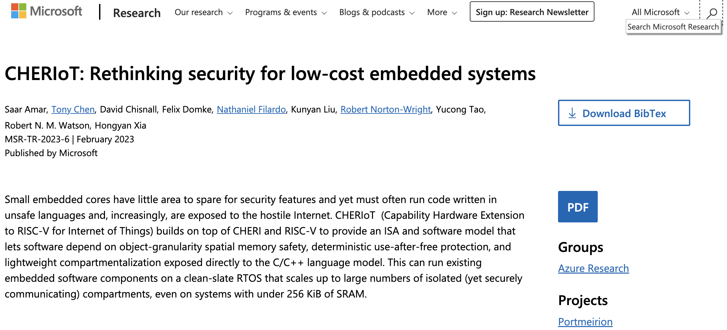

Microsoft announce CHERIoT
https://www.microsoft.com/en-us/research/publication/cheriot-rethinking-security-for-low-cost-embedded-systems/
Developer info at cheriot.org

Slide 16
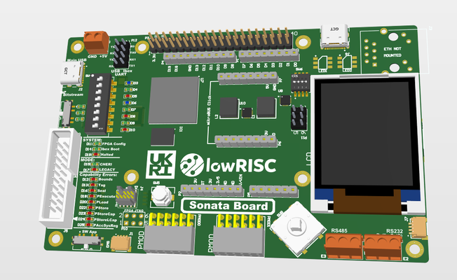

lowRISC – Sunburst
FPGA platform for CHERIoT
Builds on lowRISC OpenTitan silicon root of trust
Funded by Innovate UK, Digital Security by Design Initiative
https://www.sunburst-project.org/

Slide 17

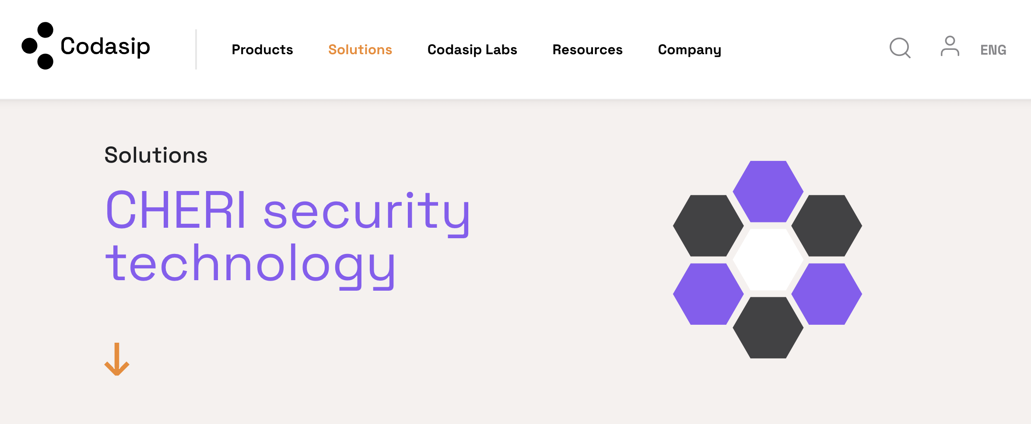
Codasip announce commercial CHERI-RISC-V
https://codasip.com/solutions/riscv-processor-safety-security/cheri/

Slide 18
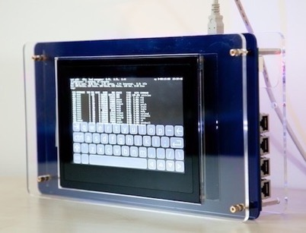
CHERI-RISC-V Open-Source Stack
CHERI-RISC-V developed open source:
Documentation (ISA ref, architecture overview, etc)
Specification in Sail
Simulators: Spike, Qemu
Clang/LLVM toolchain
OS support: CheriBSD, CheriFreeRTOS, CheriRTEMS
Hardware implementations
3-stage, 5-stage and OoO cores on FPGA including AWS F1
An early experimental FPGA-based CHERI tablet prototype running the CheriBSD operating system and applications, Cambridge, 2013
Links to research:
http://cheri-cpu.org/
links to:
https://www.cl.cam.ac.uk/ research/security/ctsrd/
CHERI-RISC-V extension for comment:
https://github.com/riscv/riscv-cheri

Slide 19
Summary
Software level
Deterministic non-bypassable memory safety (spatial and temporal)
High-performance scalable compartmentalization
Easy to adopt – recompile with very few fixes beyond bug fixes
Architecture level
Detailed implementations on RISC-V and ARM ISAs; outline x86 extension
Microarchitectural level
Demonstrably implementable
No new: indirections, tables, exception paths, register renaming, etc.
No performance impact on legacy (non-CHERI) code
Main performance hit for CHERI code is memory footprint – around 5% for SPEC
Removes the need for many software counter measures + scalable and highly performant compartmentalization

Slide 20
Conclusions
Industry is starting to adopt the technology and governments are asking for it, so we need a standard
Compatibility with existing code and other RISC-V extensions (present and future) is key
Ideally, we’d like CHERI be an option to the RVA24 profile
Or do we need to have a CHERI profile? Or CHERI universe?

